Slide 1
Data Model
-Satyendra Singh Gaur

Slide 2
Agenda
What is Data Model?
NoSQL Data Model
Categories of NoSQL Data Model

Slide 3
Data Model
This is not a Storage Model.
Data Model is how we represent data.
Relational Data Model:-
Set of Tables
Each Table has rows representing entity.
Each row has columns which describes the entity and has single value.
Every NoSQL database has different Data Model.

Slide 4
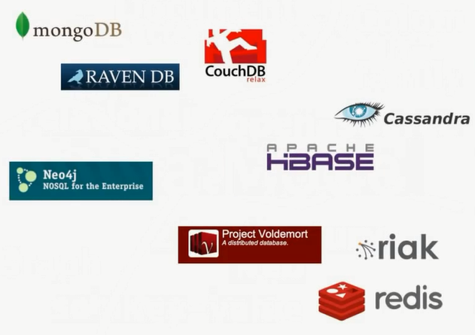

Slide 5
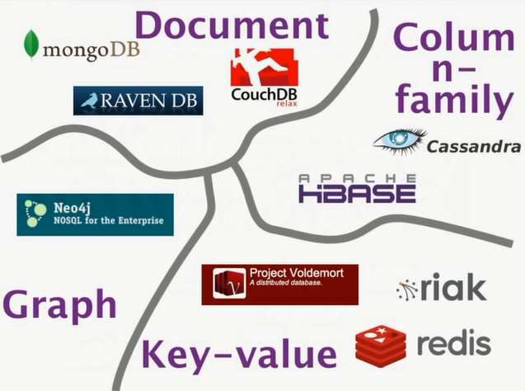

Slide 6
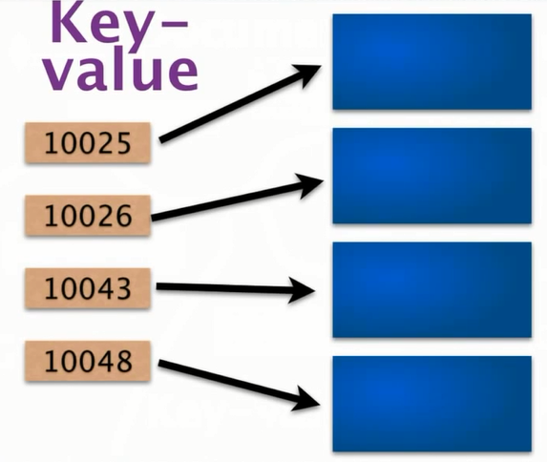
1st Data Model in NoSQL
Key | Value
10025 | Some_Video
10026 | Some_Image
10043 | Name: | Vicky
10048 | Name: | Karan
 | Age: | 26

Slide 7

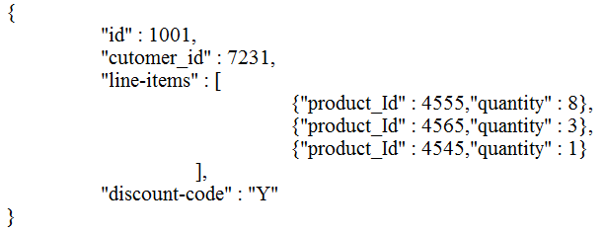

2nd Data Model in NoSQL
JSON
{
“id” : 1002,
“customer_id” : 4356
}

Slide 8
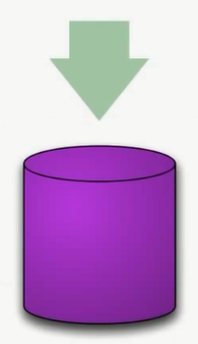
Data Models in NoSQL
Select price*qty from product where productId = 1011;
Schema

Slide 9
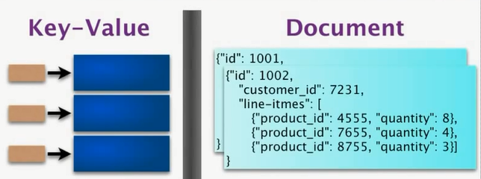
Difference between the 2 model

Slide 10
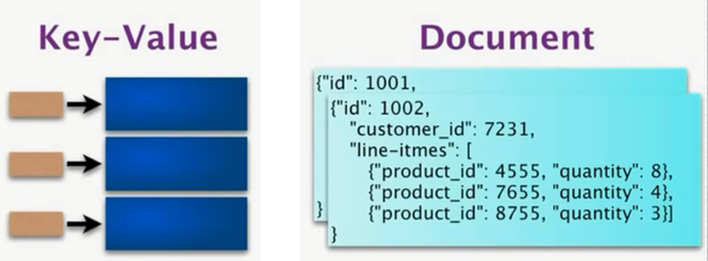
Difference between the 2 model
Key | Value
1002 | customer_id | 7231
 | Line-items | product_id | 4555 | quantity | 8
 |  | product_id | 7655 | quantity | 4
 |  | product_id | 8755 | quantity | 3
1001 | …

Slide 11
Aggregate-Oriented
Key-Value
Document

Slide 12
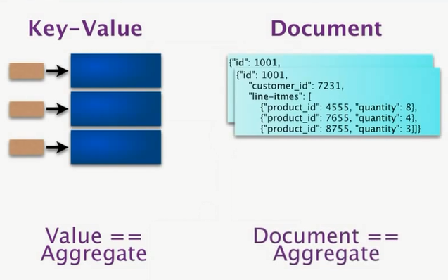

Slide 13
Aggregate Orientation
What are Aggregates?
Aggregates are complex structures.
Complex structure means, it allows lists, maps and other structures to be nested inside it.
When we think of retrieving/inserting data we think of one thing coming and going and not a part of it.

Slide 14
More on Aggregate
Aggregate is a collection of related objects that we wish to treat as a unit.
Key-Value, Column-Family and Document databases consists of aggregates as a unit.
For these databases, dealing in aggregates makes much easier to handle operating data on cluster.

Slide 15
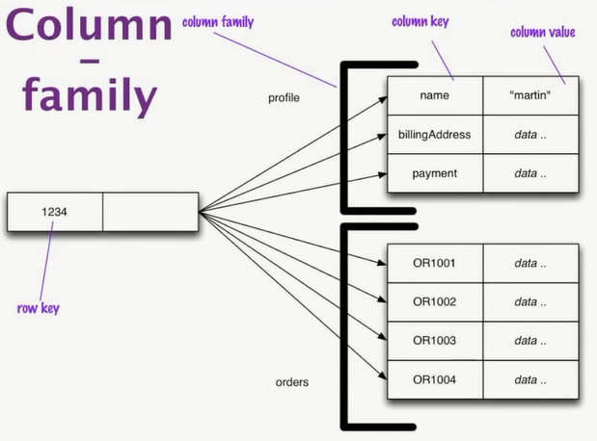
3rd Data Model in NoSQL

Slide 16
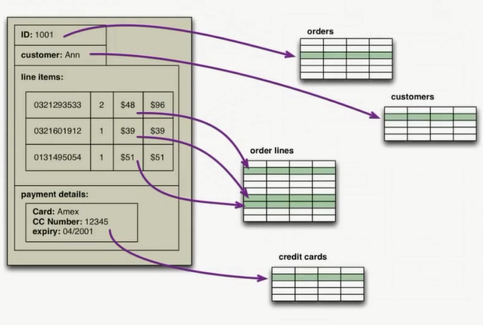

Slide 17
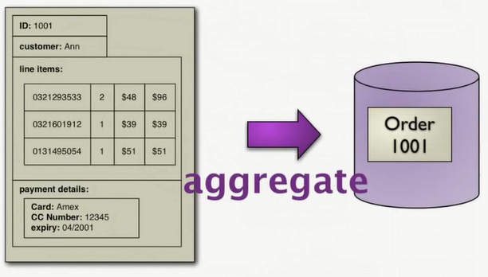

Slide 18
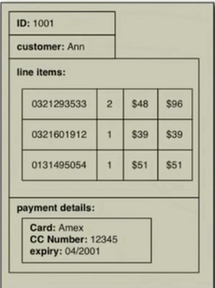
1001-1100
1101-1200
1201-1300
1301-1400
1401-1500
1501-1600
1601-1700
1701-1800
1801-1900

Slide 19
Advantages of aggregates
Retrieving and Inserting of data becomes faster.
With only id(primary key) we get whole order detail by looking at one place/node.

Slide 20
Consequences of aggregate
No foreign-key relationship
One-to-one
One-to-many
Many-to-many
Recommendation systems
Market Research and Forecasting
To predicts trend and gain profits.
Note:
This consequences have been overcome by Parallel Programming (Hadoop).

Slide 21
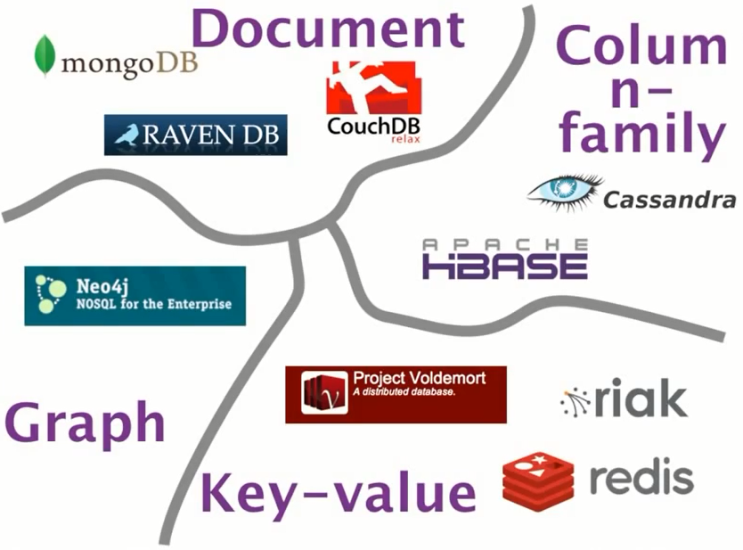

Slide 22
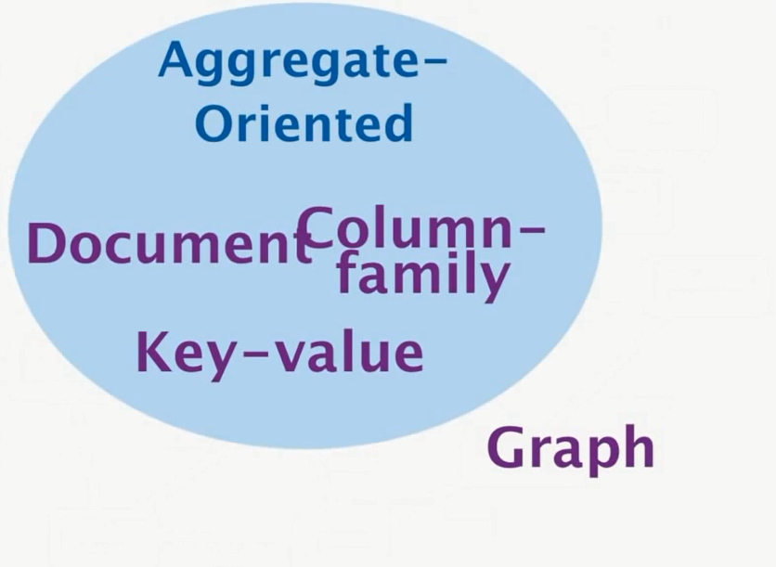

Slide 23
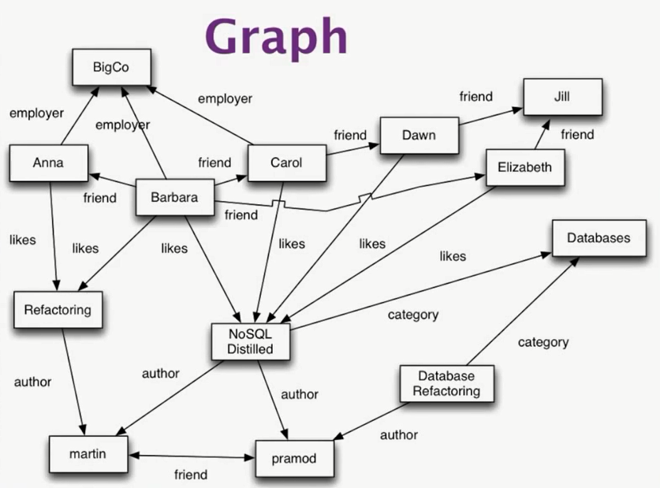

Slide 24
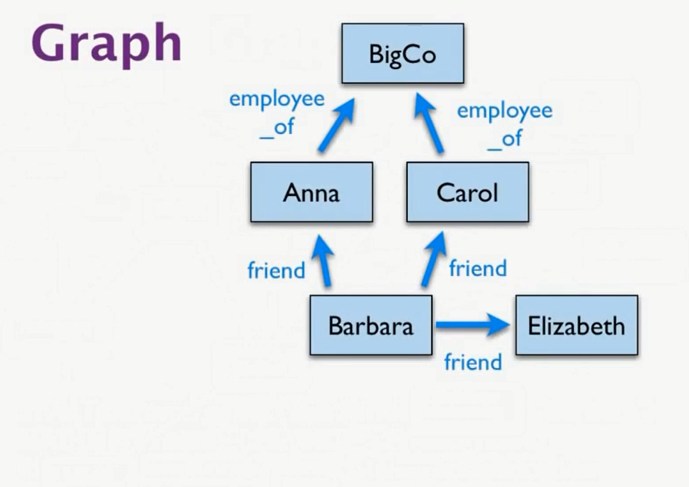
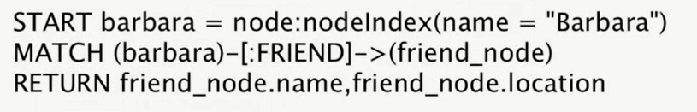

Slide 25

Flexible Schema
OR
Schemaless

Slide 26
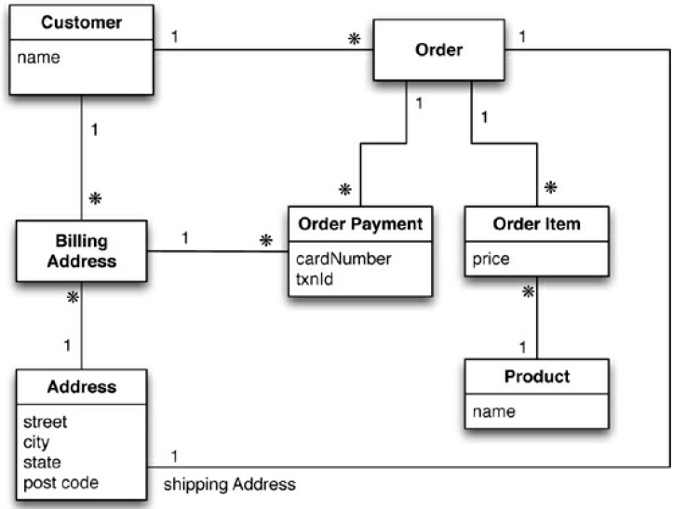
Order Processing System

Slide 27
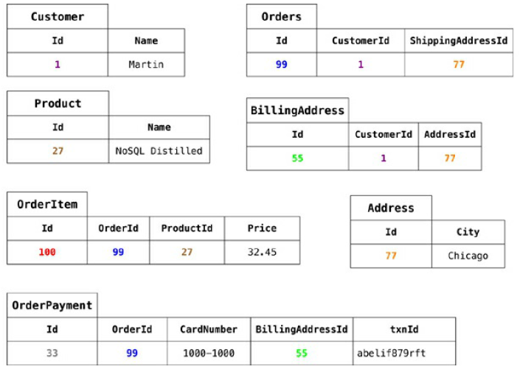
RDBMS Tables

Slide 28
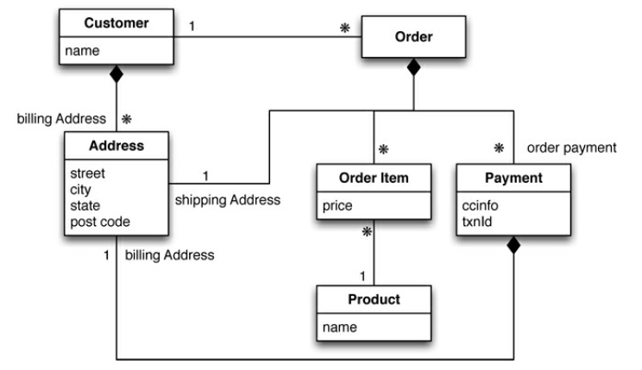
Class Diagram : Create a Document Aggregate for the below system

Slide 29
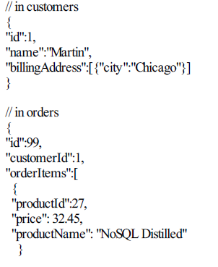
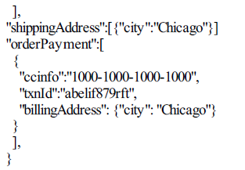
Example of Aggregate Data Model
Customer
Order

Slide 30
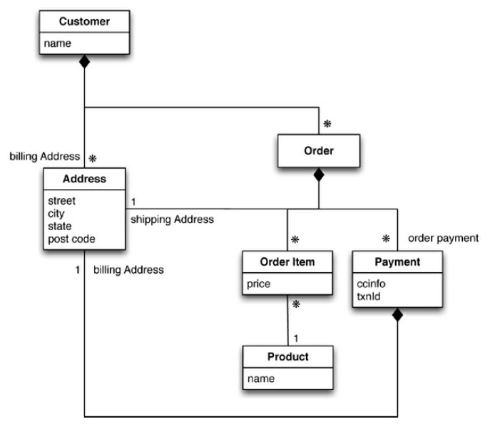
Example of Aggregate Data Model

Slide 31
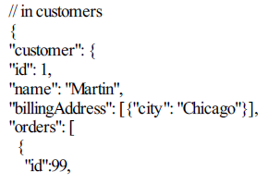
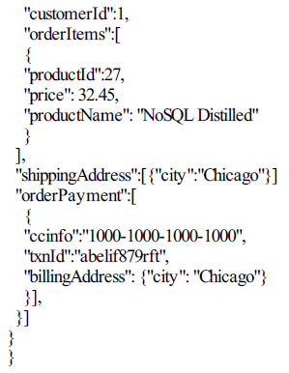
Example of Aggregate Data Model
Customer

Slide 32
Summary
An Aggregate is a collection of data that we interact with as a unit, Aggregates form the operations with the database.
Key-Value, Document, and Column-Family databases can all be seen as forms of aggregate-oriented database.
Aggregates make it easier for the database to manage data storage over clusters.
Graph databases does not follow aggregation.

Slide 33
Questions?

Slide 34
Thank You!

